Slide 1

HR DASHBOARD
A Project by Ajinkya b Adsule

Slide 2
1. Problem Statement:
Green Destination is a well known travel agency. The HR Director has recently noticed an increase in employees leaving(attrition). She would figure out any trends or patterns. She has surveyed the staff of Green Destinations and provided the data.
She would like to know the attrition rate (% of people who left the company).
She would also know if factors like age, years at the company and income play a part in determining if people will leave or not.

Slide 3
2.Objective
Provide Insights to Hr. Director for employee attrition.
The staff of Green Destinations provided the data.
Create the KPI's accordingly.
Create a dashboard

Slide 4
3. Benefits
Cost savings: Reduced revenue means lower recruitment and training costs.
Cultural improvements: A better understanding of the reasons for leaving will help foster a positive work culture.
Enhanced productivity: Lower turnover rates lead to a more stable and productive workforce.

Slide 5
4. Data attributes
Age | Attrition | BusinessTravel | DailyRate
Department | DistanceFromHome | Education | EducationField
EmployeeCount | EmployeeNumber | Environment Satisfaction | Gender
HourlyRate | JobInvolvement | Job Level | JobRole
JobSatisfaction | MaritalStatus | MonthlyIncome | MonthlyRate
NumCompaniesWorked | Over18 | OverTime | PercentSalaryHike
PerformanceRating | RelationshipSatisfaction | StandardHours | StockOptionLevel
TotalWorkingYears | TrainingTimesLastYear | WorkLifeBalance | YearsAtCompany
YearsInCurrentRole | YearsSinceLastPromotion | YearsWithCurrManager

Slide 6
5. Architecture
1. Collect Raw Data - This step involves extracting the data from different sources relevant to the problem statement or obtaining data from the client.
2. Data Wrangling – Contains following steps gathering data, assessing data, handling missing data and adding columns.
3. Exploring Data – Once the data is loaded and pre-processed, we preform data analysis using python libraries and Business Intelligence tools like Tableau public.
4. Deployment - The prepared visualizations are deployed on the public.tableau.com site. Where they will be available publicly.

Slide 7
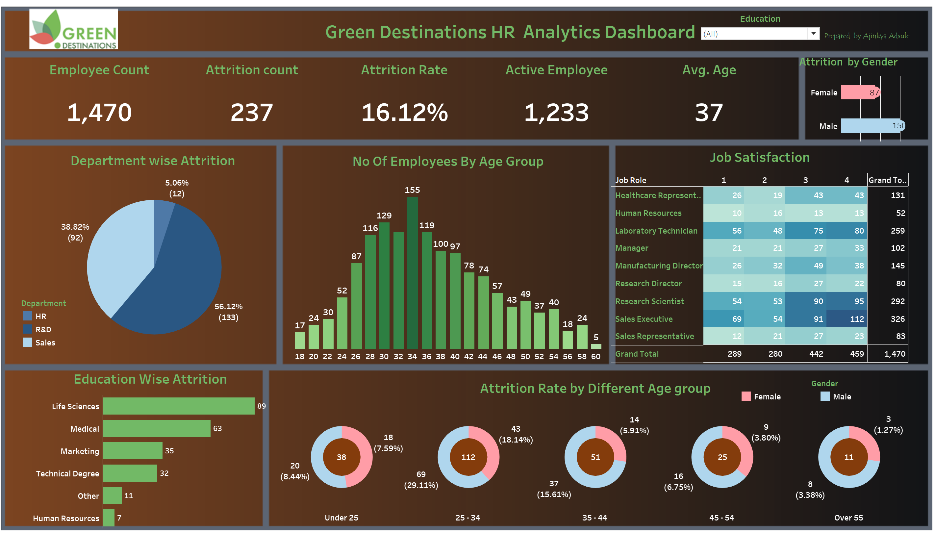
6. Insights
Notes:
Attrition % is 16.12%
Male have high attrition count.
Research & Development Department has high employee attrition.
Age group between 25-35 has high attrition.

Slide 8
7. Key Performance Indicator
Total Employees.
Active Employees.
Attrition Count.
Attrition Rate %.
Average Monthly Income.
Average salary hike %.

Slide 9
8.Recommendations and improvement techniques:
The dashboard provides helpful suggestions to reduce attrition, such as:
Employee engagement program: Implement programs to increase employee engagement and satisfaction.
Career development plans: Yield advancement opportunities and a clear career path.
Compensation and Benefits Evaluation: To remain competitive, compensation and benefits must be evaluated regularly.
Flexible working Arrangements: Offer flexible working arrangements to improve work-life balance

Slide 10
9. Conclusion
The HR Attrition Analytics dashboard is a valuable resource for HR professionals and decision-makers seeking to better understand employee attrition. Companies may effectively reduce turnover and establish a stable, engaged, and productive workforce by studying demographic determinants, tracking KPIs, and applying improvement measures. more efficient.

Slide 11
Q&A
Q1) What’s the source of data?
➢ The Dataset was taken from Unified Mentor’s Provided Project Description Document.
Q2) What was the type of data?
➢ The data was the combination of numerical and Categorical values.
Q 3) What’s the complete flow you followed in this Project?
➢ Refer Architecture for better Understandings
Q4) What techniques were you using for data?
➢ Removing unwanted attributes
➢ Visualizing relation of independent variables with each other
➢ Cleaning data by removing column with missing values
➢ Converting Numerical data into Categorical values

